Slide 1

7th Grade Math
Unit 9, Lesson 1 Adding and Subtracting Linear Expressions with Integer Coefficients Volume 2, pg. 39

Slide 2


Benchmark
MA.7.AR.1.1
Apply properties of operations to add and subtract linear expressions with rational coefficients.
volume 2, pg. 39

Slide 3
Integrated Mathematical Thinking and Reasoning Standards
MA.K12.MTR.2.1 Demonstrate understanding by representing problems in multiple ways.
MA.K12.MTR.5.1 Use patterns and structure to help understand and connect mathematical concepts.
volume 2, pg. 39

Slide 4

Learning Target
I can use algebra tiles to add and subtract linear expressions.
volume 2, pg. 39

Slide 5

Warm-Up
volume 2, pg. 39

Slide 6
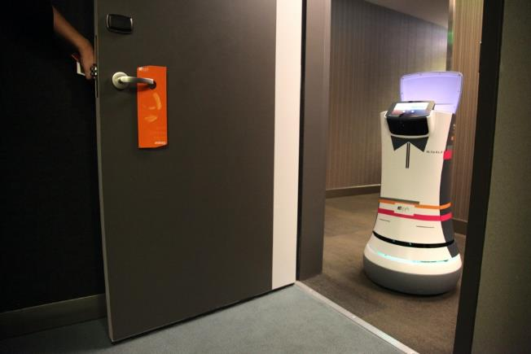
9.1.1 Warm-Up: Career in Robotics
Tessa Lau is the Chief Robot Whisperer for a robotics company. The company creates robot helpers for the service industry. Some of their robots perform tasks like delivering items to guests at a hotel. Tessa has studied applied physics, computer science, artificial intelligence, and human-computer interaction. She loves hands-on experiments, building things, and the speed of creating with computers. Through programming and engineering, one of her primary jobs is to look at a robot in context and make sure the robots behave well in human environments.
volume 2, pg. 39

Slide 7
Have you ever considered a career as an engineer?
How do you think a robot could be helpful to you in your everyday life?
Tessa’s advice is “Don’t listen to someone who tells you that you can’t do something.” Describe a time someone told you that you were not able to do something.
volume 2, pg. 39

Slide 8

Refresher
volume 2, pg. 40

Slide 9

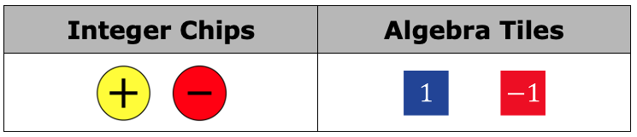

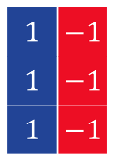
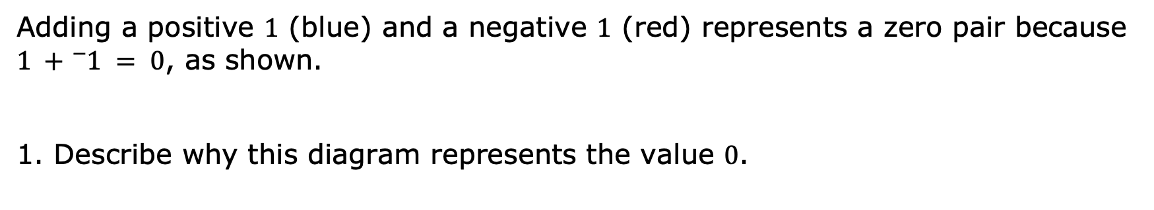
9.1.2 Refresher: Adding and Subtracting Integers with Algebra Tiles
Algebra tiles, like integer chips, can be used to model adding and subtracting integers. Each small square represents a positive $1$ (blue) or a negative $1$ (red).
Adding a positive $1$ (blue) and a negative $1$ (red) represents a zero pair because $1 +{}_{ }^{−}1 = 0$, as shown.
1. Describe why this diagram represents the value $0$.
volume 2, pg. 40

Slide 10
A zero pair is a pair of numbers whose sum is zero.
volume 2, pg. 40

Slide 11
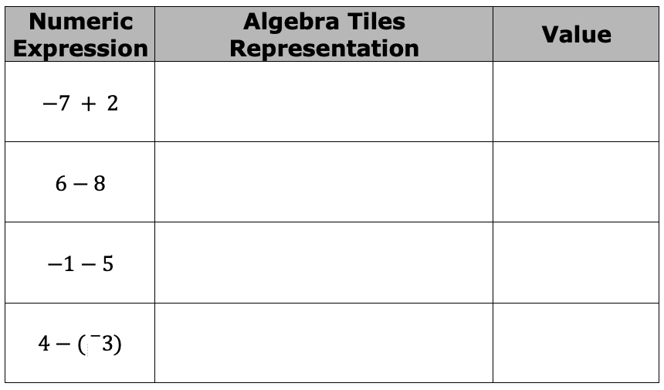
2. Complete the following problems.
Complete the table.
For some of the representations with algebra tiles, zero pairs had to be added to the representation. Put an asterisk (*) next to the expressions where this was the case.
Explain why zero pairs had to be added to the representation in these cases.
volume 2, pg. 40

Slide 12

Guided Instruction
volume 2, pg. 41

Slide 13
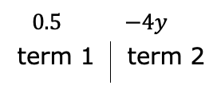
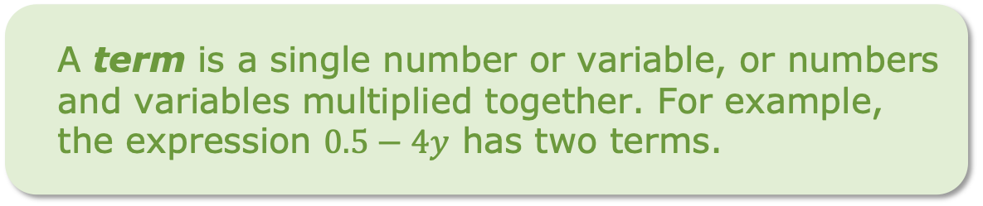

9.1.3 Guided Instruction: Algebra Vocabulary
There are some fundamental definitions that are necessary to know for working with algebraic expressions.
The expression $0.5−4y$ has two terms.
One of the terms in this expression is a constant term.
1. Which term is the constant term? Explain.
A term is a single number or variable, or numbers and variables multiplied together. For example, the expression $0.5−4y$ has two terms.
volume 2, pg. 41

Slide 14

An expression is a mathematical statement containing numerals, operators, grouping symbols, and symbols or variables for unknown values. An expression does not contain an equal sign or inequality symbol.
For example, $4 + 5$ , $3x−2$, and $6x−7y+11$ are all expressions.
volume 2, pg. 41

Slide 15
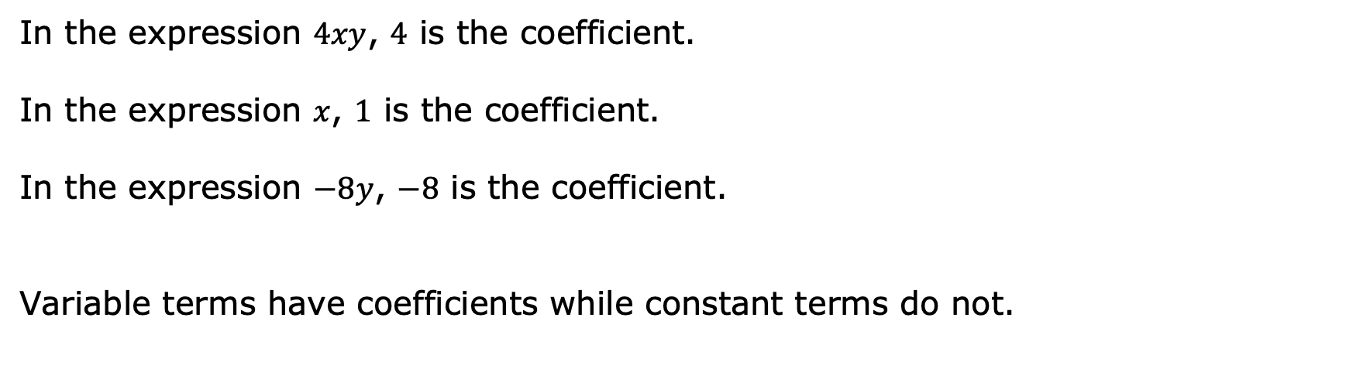
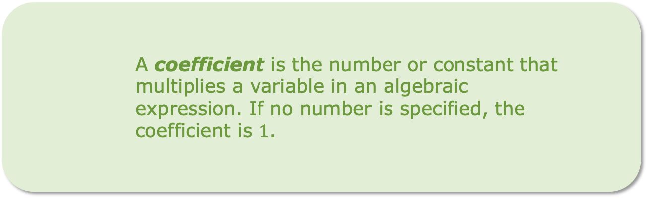
A coefficient is the number or constant that multiplies a variable in an algebraic
expression. If no number is specified, the
coefficient is $1$.
In the expression $4xy$, $4$ is the coefficient.
In the expression $x$, $1$ is the coefficient.
In the expression $−8y$, $−8$ is the coefficient.
Variable terms have coefficients while constant terms do not.
volume 2, pg. 41

Slide 16

Exploration
volume 2, pg. 42

Slide 17

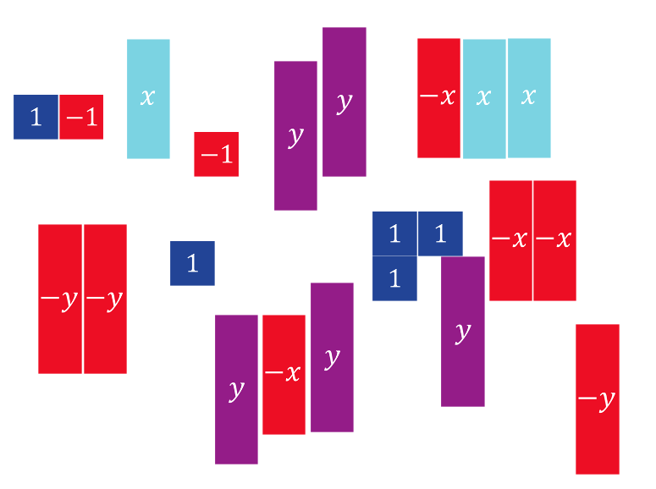
9.1.4 Exploration: What Are Like Terms?
Here is a collection of algebra tiles.
volume 2, pg. 42

Slide 18

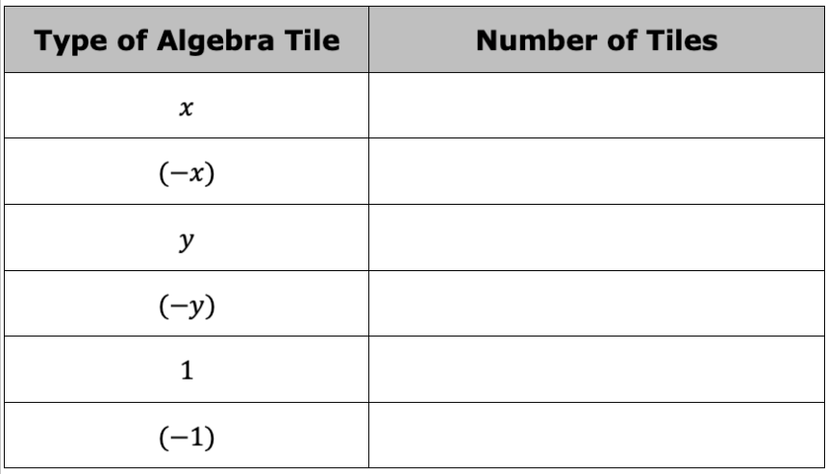
Complete the table below.
volume 2, pg. 42

Slide 19
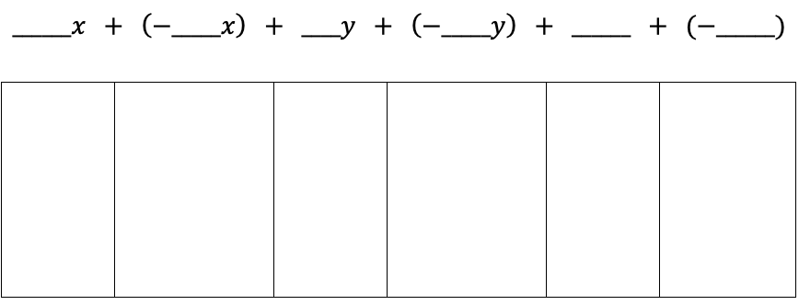
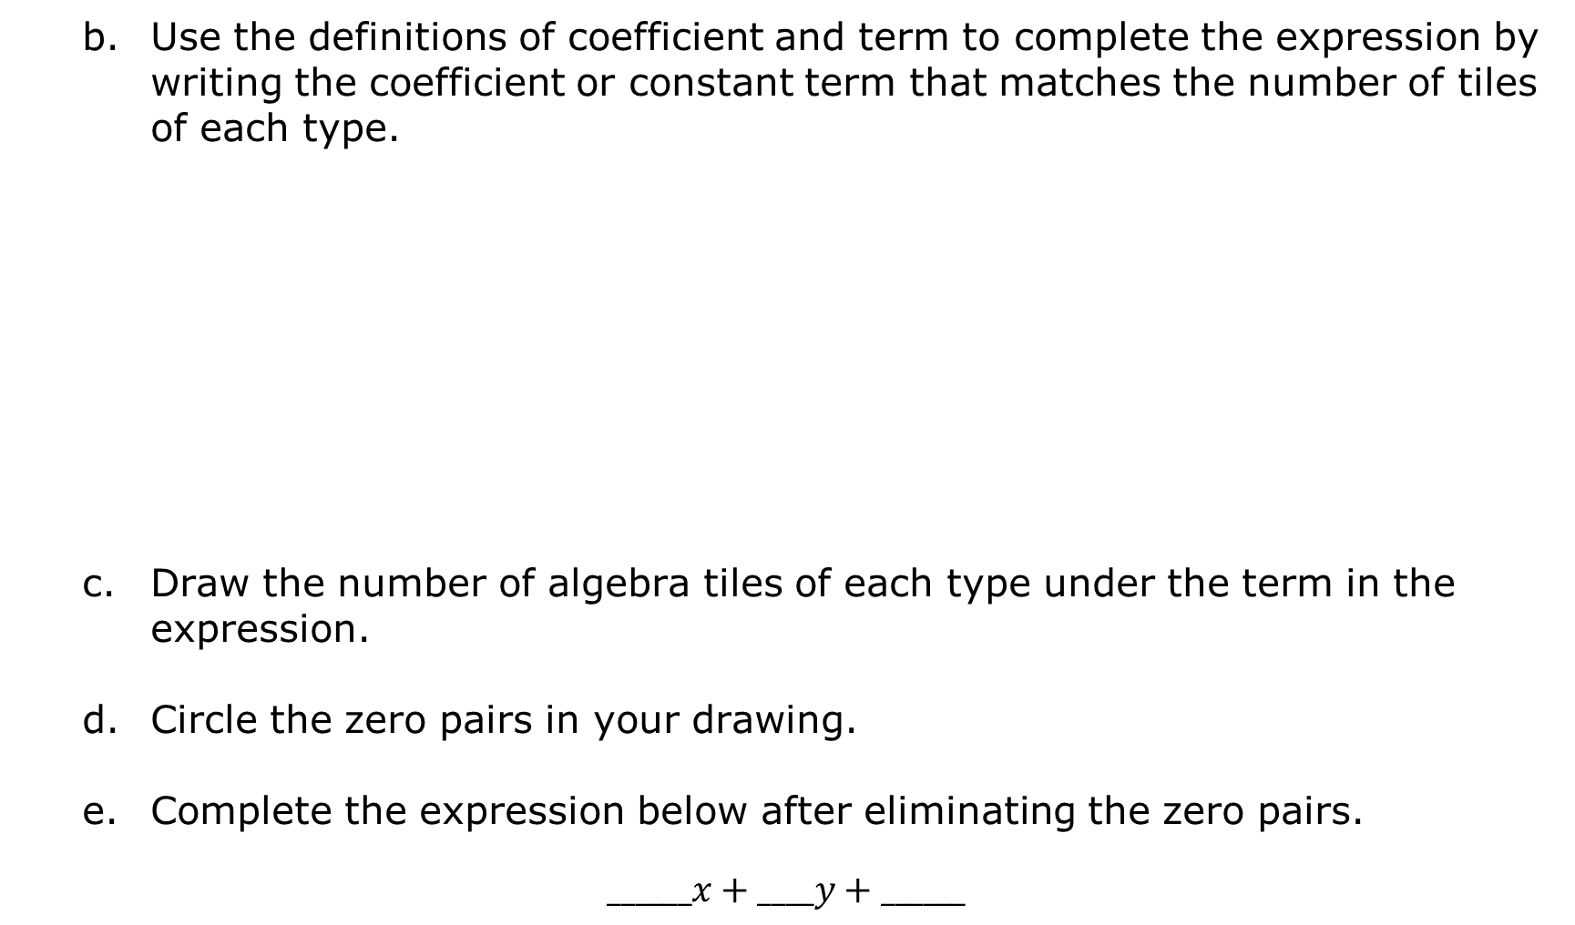
Use the definitions of coefficient and term to complete the expression by writing the coefficient or constant term that matches the number of tiles of each type.
Draw the number of algebra tiles of each type under the term in the expression.
Circle the zero pairs in your drawing.
Complete the expression below after eliminating the zero pairs.
$$______x+____y+______$$
volume 2, pg. 42

Slide 20
Like terms are terms with the exact same variable(s) raised to the same exponent.
A constant is a fixed numerical value with no variables. All constants are like terms.
volume 2, pg. 42

Slide 21
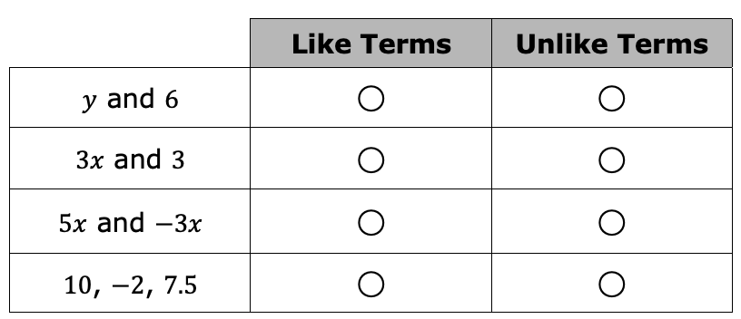
2. Answer the following questions about like terms.
Classify the following terms.
How did you determine whether the terms were like or unlike?
Compare answers with your partner.
volume 2, pg. 43

Slide 22
Guided Instruction
volume 2, pg. 43

Slide 23
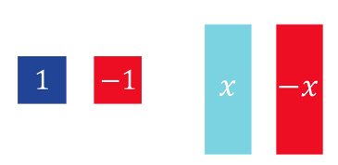
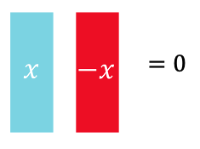
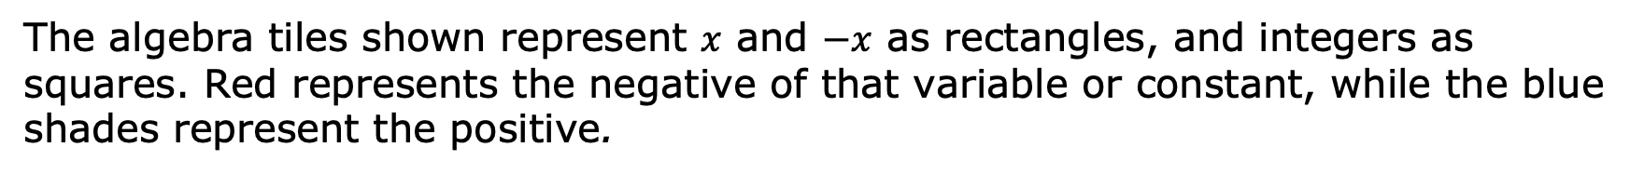
9.1.5 Guided Instruction: Adding and Subtracting Expressions with Algebra Tiles
The algebra tiles shown represent $x$ and $−x$ as rectangles, and integers as squares. Red represents the negative of that variable or constant, while the blue shades represent the positive.
Variables also form zero pairs, as shown.
volume 2, pg. 43

Slide 24
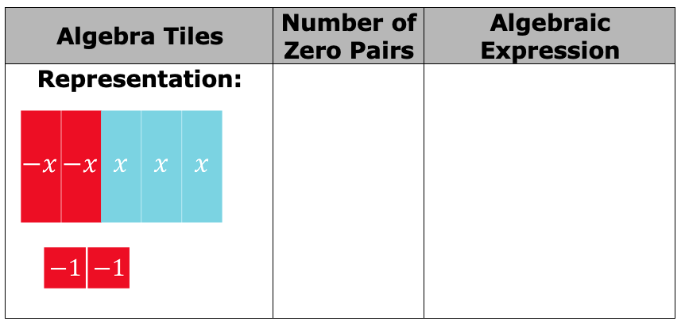
Complete the table by crossing out the zero pairs and recording how many there are. Write the resulting algebraic expression after eliminating the zero pairs.
volume 2, pg. 43

Slide 25
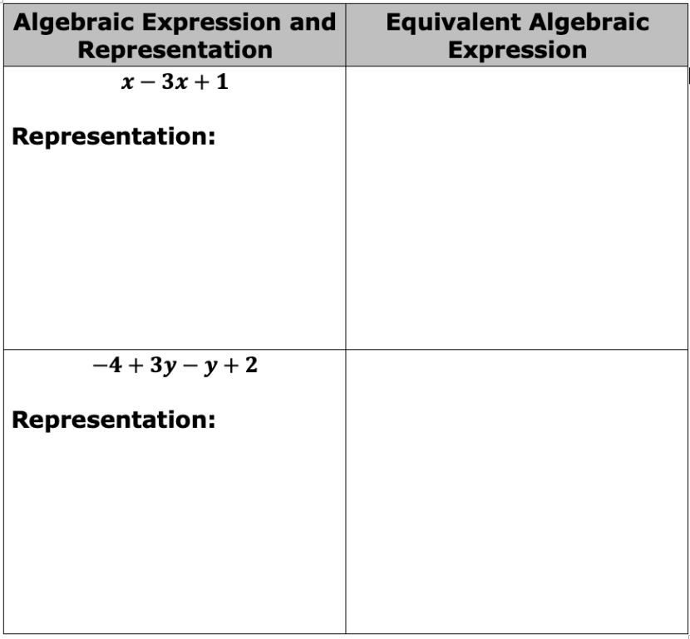
Draw a representation of the following expressions with algebra tiles. Cross out any zero pairs. Then write an equivalent algebraic expression after eliminating any zero pairs.
volume 2, pg. 44

Slide 26

Guided Practice
volume 2, pg. 44

Slide 27

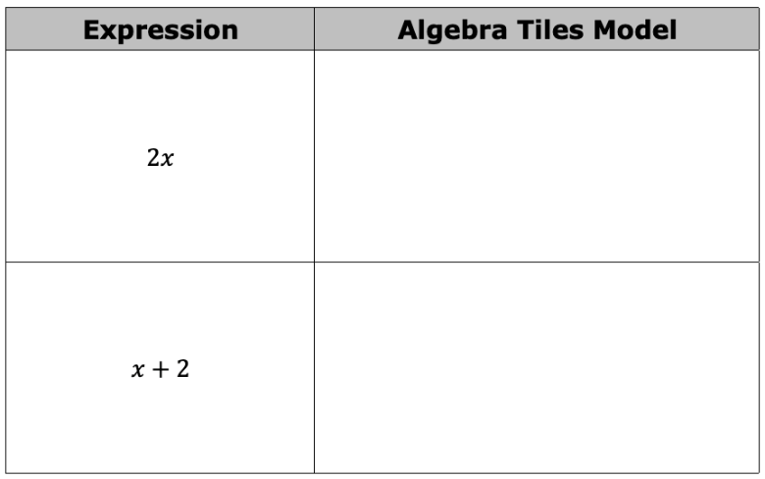

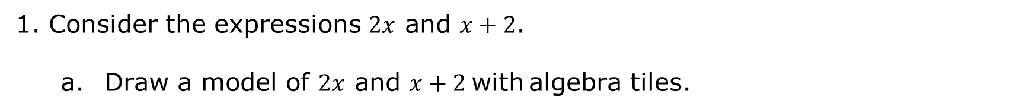
9.1.6 Guided Practice: Adding and Subtracting Expressions with Algebra Tiles
Consider the expressions $2x$ and $x+2$.
Draw a model of $2x$ and $x+2$ with algebra tiles.
How are they different?
Are $2x$ and $x+2$ equivalent algebraic expressions?
volume 2, pg. 44

Slide 28

Your Turn
volume 2, pg. 45

Slide 29

9.1.7 Your Turn!
Write an equivalent expression by combining like terms.
$2x+4x=$_____________________
$−y+7+4y−1=$ _______________
$x−x+x−x+1=$ _______________
$8x−4−4x=$ __________________
$2x−4x=$ _____________________
volume 2, pg. 45

Slide 30

Wrap-Up
volume 2, pg. 45

Slide 31
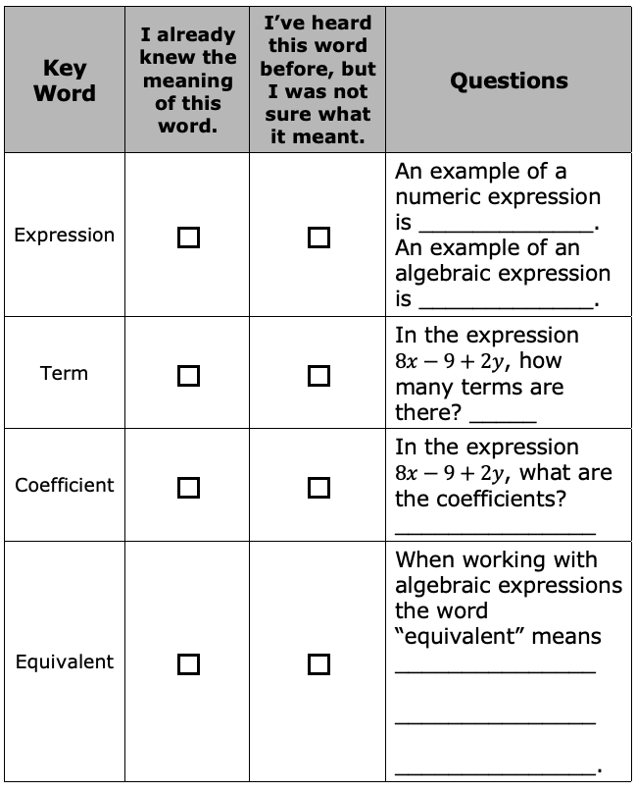
9.1.8 Wrap-Up: Cool Down
For each key word, check the box in the column that describes your knowledge of the word. Then answer the questions or complete the statements in the last column.
volume 2, pg. 45

